Slide 1
Chapter 12
Information Systems Development
Notes:
As a future business professional, you will be involved in the development of new technology applications to your business. You may take the lead, as Jared has been doing in developing PRIDE, or you might be an office manager who implements procedures and trains people in the use of systems such as PRIDE. Or, you might become a business analyst and work as a liaison between users and technical staff.
If nothing else, you may be asked to provide requirements and to test the system to ensure those requirements have been met. Whatever your role, it is important that you understand how processes and systems are developed and managed.

Slide 2
"We Think We Can Open the Doors to an Entirely New Market"
Example of decision making in small company
Zev, owner and source of investment funds
Team presents options, he listens and makes a decision
Team not really sure what’s involved
Building Xbox prototype good, low cost way to learn
Notes:
GOALS
Use the PRIDE System to:
Demonstrate a typical software development meeting in a small startup.
Show the wide range in development options and costs that can exist.
Illustrate the use of a prototype for reducing risk.
Provide a setting for a discussion of scrum.

Slide 3
Bottom Line
Startups can be fun and interesting places to work
Time and budgets limited
Decisions usually made more quickly, but risky if not well managed
Prototypes used to reduce front-end risk
Scrum ideal development process for creating prototypes

Slide 4
Study Questions
Q1: What is systems development?
Q2: Why is systems development difficult and risky?
Q3: What are the five phases of the SDLC?
Q4: How is system definition accomplished?
Q5: What is the users’ role in the requirements phase?
Q6: How are the five components designed?
Q7: How is an information system implemented?
Q8: What are the tasks for system maintenance?
Q9: What are some of the problems with the SDLC?
How does the knowledge in this chapter help you?
Notes:
Remind students that as a business professional, they will be involved in the development of new technology applications their business, and may take the lead in in developing an application.

Slide 5
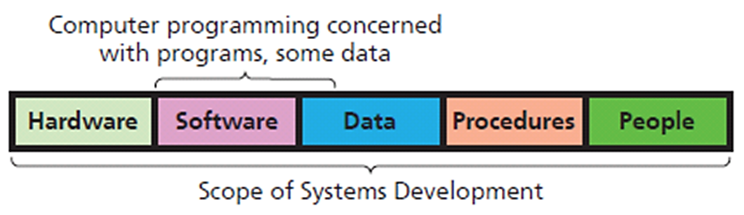
Q1: What is Systems Development?
Process of creating and maintaining information systems
Involves all five components of IS model
Requires
Establishing system goals
Setting up the project
Determining requirements
Business knowledge and management skill

Slide 6
How Do Business Processes, Information Systems, and Applications Differ and Relate?
1. Business processes, information systems, applications have different characteristics and components
2. Relationship of business processes to information systems many-to-many (N:M)
Process need not relate to any information system, but information system relates to at least one business process
3. Every IS has at least one application because every IS has a software component
Notes:
People confuse these terms. They’ll quickly switch back and forth among processes, systems, and applications without knowing they’ve changed terms and contexts.
With these understandings, you can add value to your team simply by clarifying these differences.

Slide 7
Q2: Why is Systems Development Difficult and Risky?
Many projects never finish
Often 200-300% over budget
Some don't accomplish goals
High risk of failure
Even with competent people following appropriate methodology

Slide 8
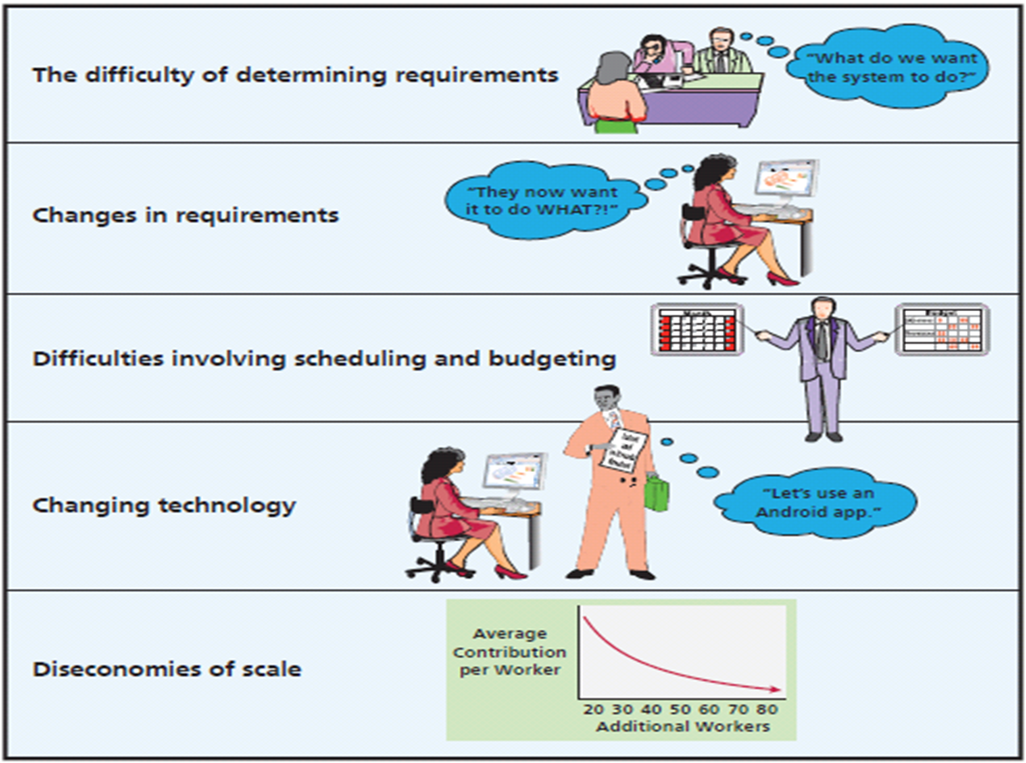
Major Challenges to System Development
Notes:
Before system can be finalized, detailed requirements need to be specified.

Slide 9
Difficulty of Requirements Determination
What specifically is system to do?
What should a doctor’s reports look like?
Standard and exception reports? Reports fixed structure or user modifiable? If modifiable, how?
How many practices and how many patients per practice will PRIDE support?
How much cloud resource needed?
Must create environment where difficult questions are asked and answered
Notes:
PRIDE system started with a prototype. As they think about operational system, what are the true requirements?
What does privacy mean, in details? Who sets patient privacy policy? Who can change it? What granularity of permission is needed? As any experienced systems analyst knows, there will undoubtedly be important questions that no one knows to ask.

Slide 10
Changes in Requirements
Aims at moving target
Bigger system, longer project, more requirements will change
What should development team do?
Incorporate changes along the way or make changes in maintenance phase?
Notes:
Midway through development process, a major health club chain approaches Flores with a lucrative contract proposal. That proposal necessitates major changes in PRIDE's planned reporting requirements.

Slide 11
Scheduling and Budgeting Difficulties
How long to build it?
How long to create data model?
How long to build database applications?
How long to do testing?
How long to develop and document procedures?
How long for training?
How many labor hours? Labor cost?
What’s the rate of return on investment?
Notes:
If you cannot estimate how much a system costs, then how do you perform a financial analysis to determine if system generates an appropriate rate of return?

Slide 12
Changing Technology
Stop development to switch to new technology?
Finish developing according to existing plan?
Why build an out-of-date system?
Can you afford to keep changing the project?
Notes:
Example: While developing PRIDE's maintenance application, Apple, Microsoft, and Google and their business partners release hot, new mobile devices with vastly improved graphics and animation. You know these new devices can create far better animations. What to do?

Slide 13
Diseconomies of Scale
Brooks’ Law
“Adding more people to a late project makes the project later”
Veteran members train new staff and lose productivity while training
Schedules can be compressed only so far
Once a project is late and over budget, no good choices exist
Notes:
“Nine women cannot make a baby in one month.”

Slide 14
Is It Really So Bleak?
Yes and No
Successful methodologies exist
When supported and managed properly
Systems development life cycle (SDLC), still most common methodology

Slide 15
Q3: What Are the Five Phases of the SDLC?
1. System definition
2. Requirements analysis
3. Component design
4. Implementation
5. Maintenance
Notes:
SDLC is the traditional process used to develop information systems and applications. The IT industry developed the SDLC in the “school of hard knocks.” Many early projects met with disaster, and companies and systems developers sifted through the ashes of those disasters to determine what went wrong.
Different authors and organizations package the tasks into different numbers of phases, such as 5, 7, or 8. Here is a 5-phase SDLC.

Slide 16
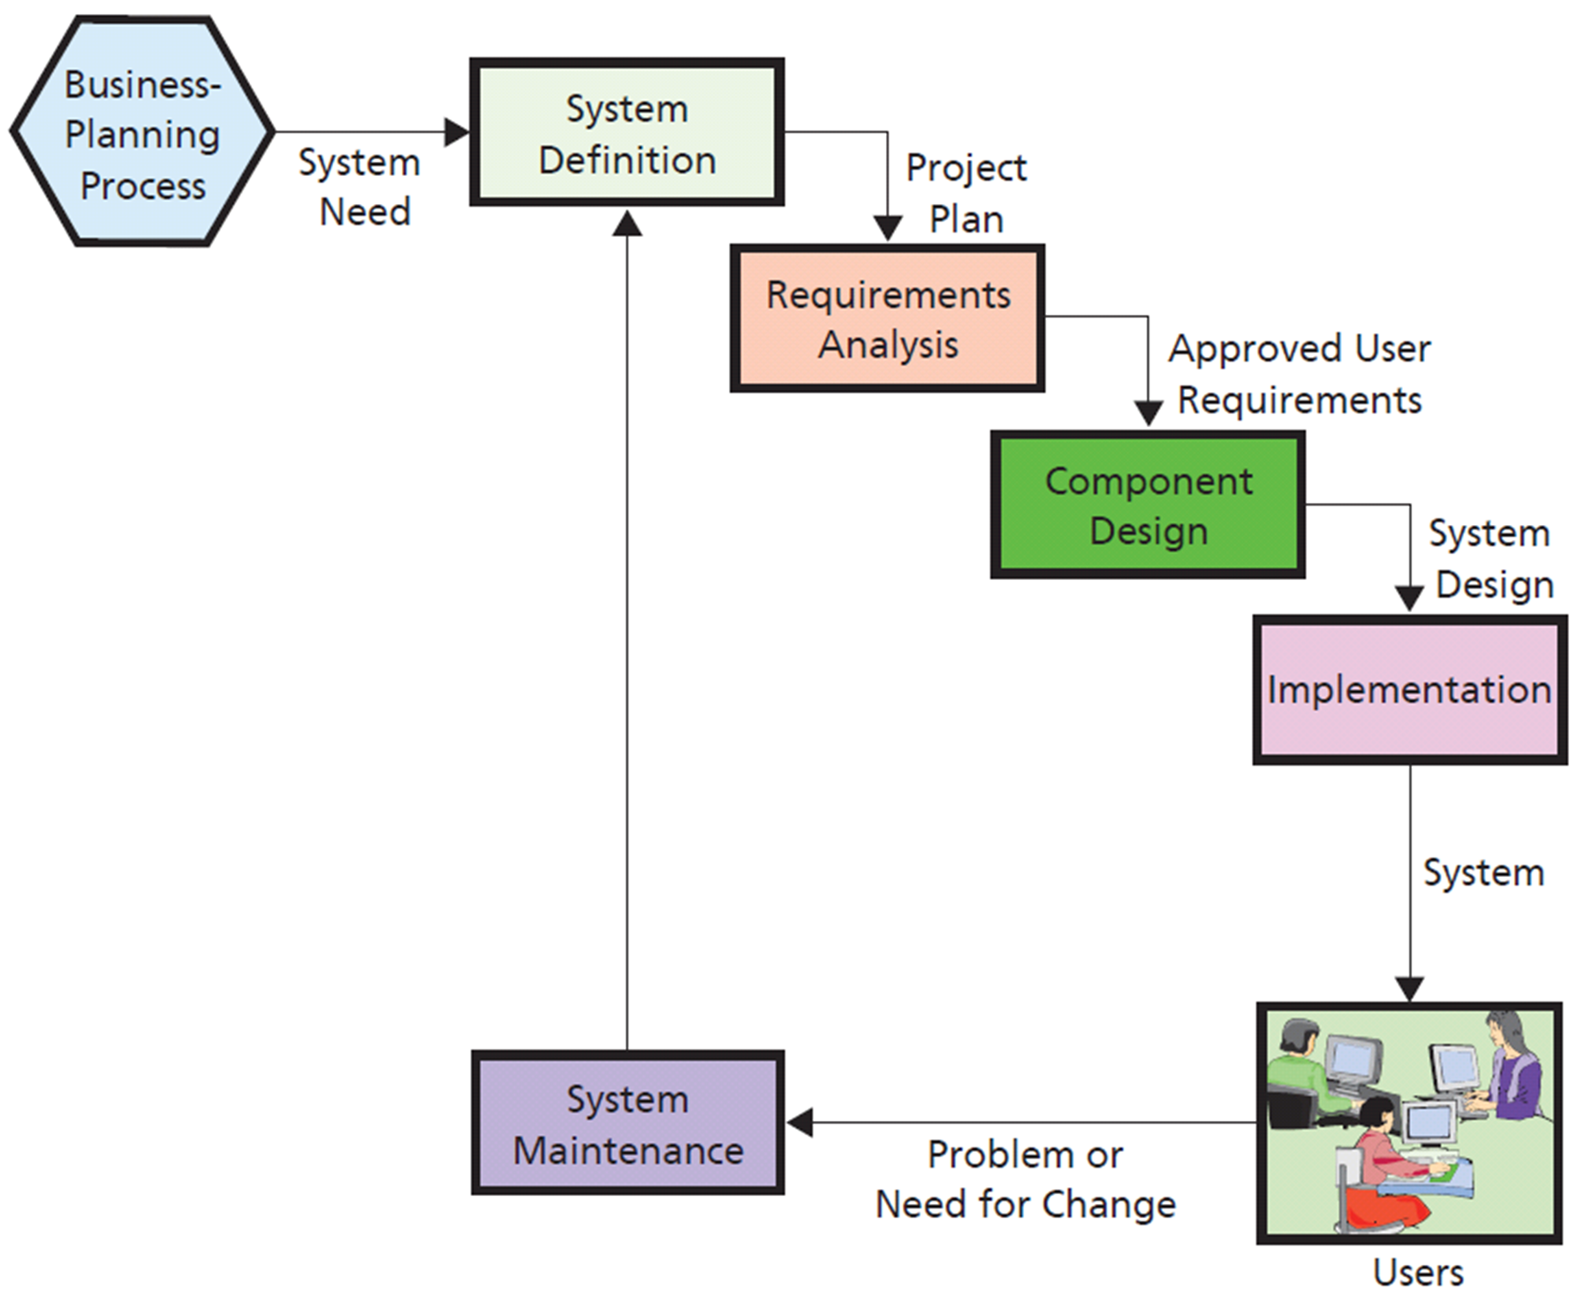
Q4: What Are the Phases in the Systems Development Life Cycle (SDLC)?
Waterfall method
Notes:
In the Waterfall method, once you leave a phase you don’t go back. You must keep flowing downstream.

Slide 17
Q4: How is System Definition Accomplished?
Assign a few employees, possibly on a part-time basis, to define new system, assess its feasibility, and plan project
Members include users, managers, and IS professionals

Slide 18
Define System Goals and Scope (Example)
Define goal and purpose in terms of organization’s competitive strategy
How will Xbox application contribute to more ad revenue?
Will it enable PRIDE Systems to earn more from current clients?
Will it attract new clients?
What major features of application need to be implemented?
Define specific business activities, users, business processes, plants, offices, and factories involved

Slide 19
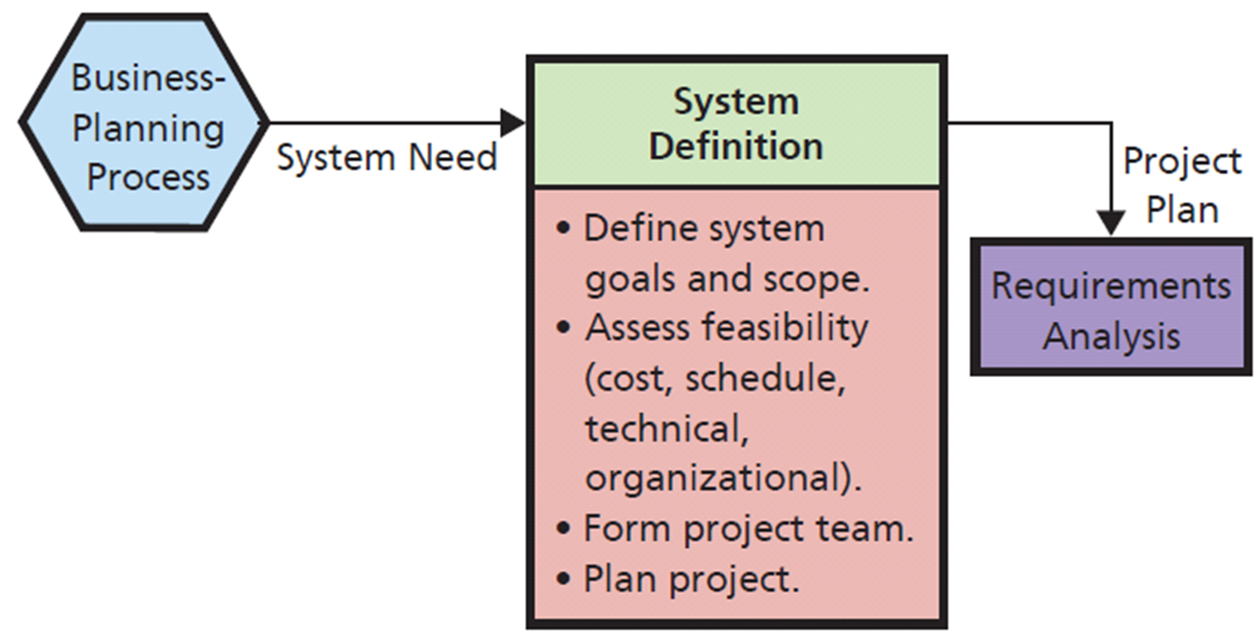
Define System Goals and Scope
Notes:
At the start, cost and schedule feasibility are only an approximation or back-of-the-envelope analysis.
Eliminate any obviously infeasible ideas as soon as possible.
The scope might be defined by specifying the users, or the business processes, or the plants, offices, and factories that will be involved.
Feasibility has four dimensions: Cost, schedule, technical, organizational.
Cost feasibility depends on the scope of project.
Schedule feasibility difficult to determine because hard to estimate time it will take to build a system.
Technical feasibility refers to whether existing information technology can meet needs of new system.
Organizational feasibility concerns whether new system fits organization’s customs, culture, charter, or legal requirements.

Slide 20
Form a Project Team
Typical development team
Systems analyst/business analyst
Managers
Programmers
Software testers
Users
Outside contractor
Notes:
Normally, consists of both IS professionals and user representatives. Project manager and IS professionals can be in-house personnel or outside contractors.
Business analysts specialize in understanding business needs, strategies, and goals and helping businesses implement systems to accomplish competitive strategies.
Systems analysts are IT professionals who understand both business and technology.

Slide 21
Team Composition Changes Over Time
Requirements definition
Heavy with business and systems analysts
Design and implementation
Heavy with programmers, testers, and database designers
Integrated testing and conversion
Augmented with testers and business users
Important point: users must be actively involvement and take ownership of development project
Notes:
First major task for project team is to plan project. Members of project team specify tasks to be accomplished, assign personnel, determine task dependencies, and set schedules.

Slide 22
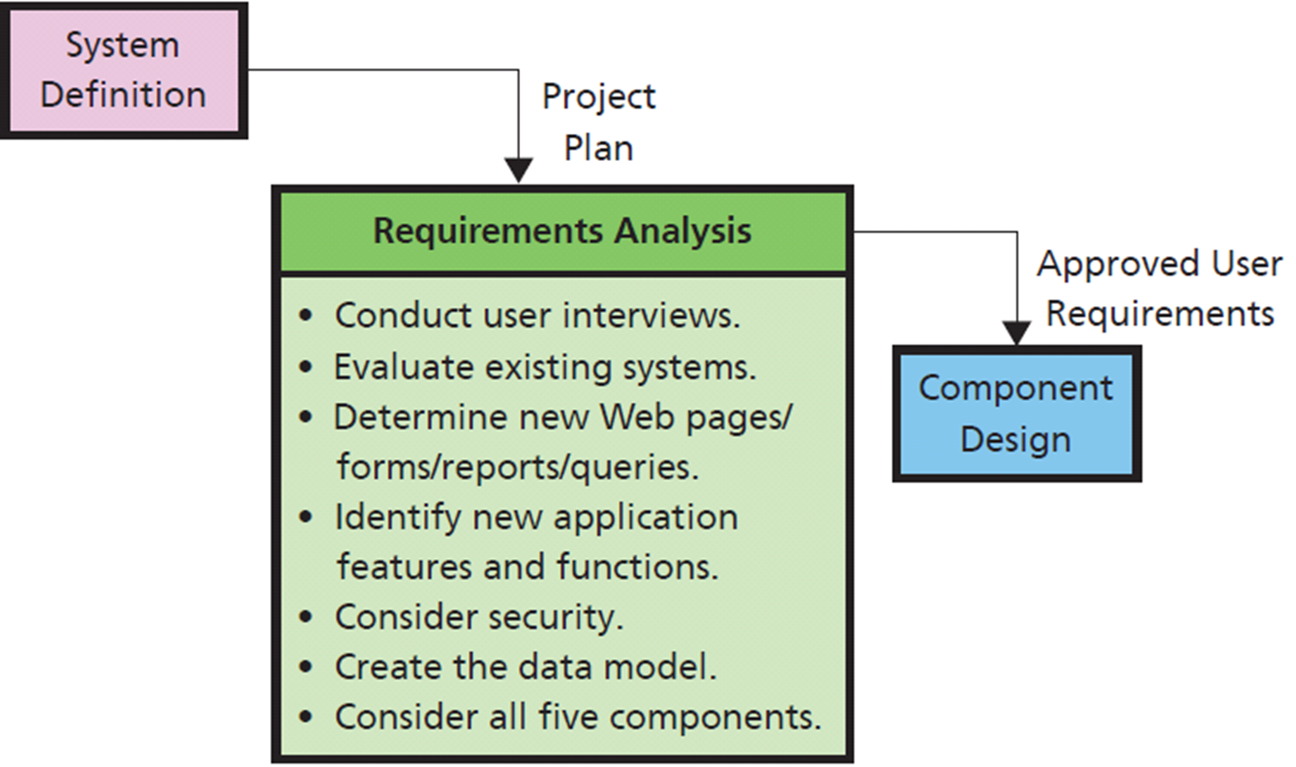
Q5: What is the Users’ Role in the Requirements Phase?
Interviewing skills crucial
Notes:
Most important phase in the systems development process. If requirements are wrong, the system will be wrong. If requirements are determined completely and correctly, then design and implementation will be easier and more likely to result in success.

Slide 23
So What? Using This Knowledge for Your Number-One Priority
Between now and graduation, finding and getting “that” job should be your number-one priority
How will you do that?
Interpret each activity in SDLC as they pertain to finding your job
Sketch the job-acquisition process you are currently using (BPMN symbols)
Notes:
In-class exercise.

Slide 24
So What? Using This Knowledge for Your Number-One Priority (cont’d)
Explain two ways you could improve your job-acquisition process
Write the requirements for the job-acquisition process using scrum-like requirements statements
How do those answers inform you about how to obtain that perfect job

Slide 25
Q6: How are the Five Components Designed?
Determine hardware specifications
Determine software specifications
Design database
Design Procedures
Normal, backup, and failure recovery procedures
Design Job Descriptions
Create and define new tasks and responsibilities
Notes:
Team designs each component by developing alternatives, evaluating each alternative against requirements, and selecting among those alternatives.
Accurate requirements are critical; if they are incomplete or wrong, then they will be poor guides for evaluation.

Slide 26
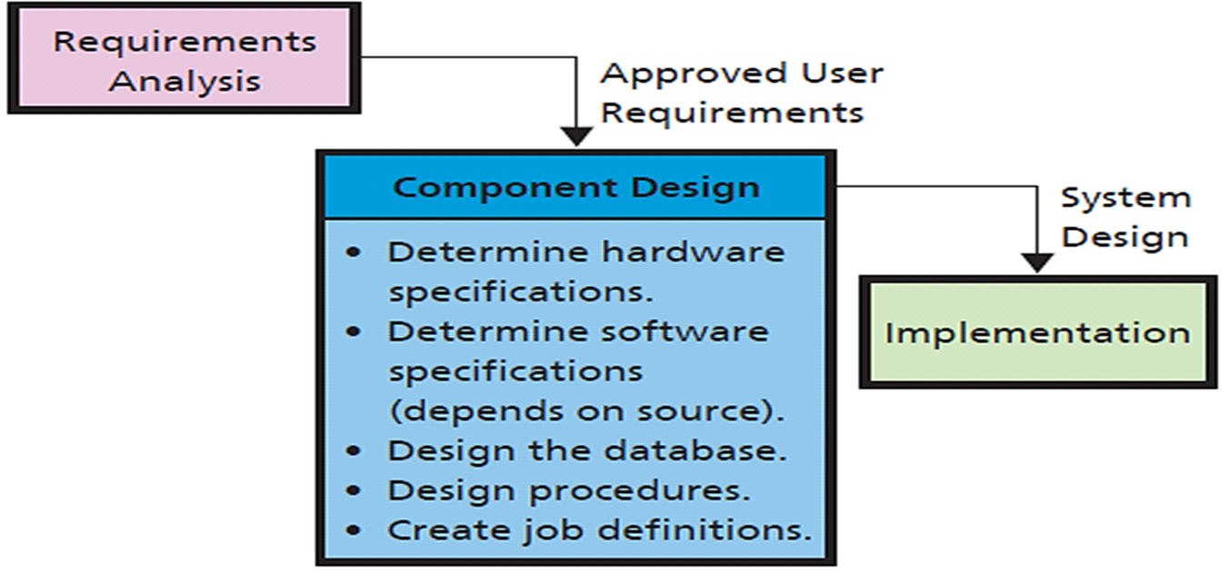
SDLC: Component Design Phase
Notes:
Team determines hardware specifications required for the application.
Program design depends on the source of the programs. For off-the-shelf software, team must determine candidate products and evaluate them against the requirements. For off-the-shelf with alteration programs, team identifies products to be acquired off-the-shelf, then determines alterations required. For custom-developed programs, team produces design documentation for writing program code.
The prototype can be useful in this phase also.
Design involves developing job descriptions for the various roles. These descriptions detail responsibilities, skills needed, training required, and so forth.

Slide 27
Hardware, Database, and Procedure Design
Hardware design
Determine specifications and source of hardware
Purchase, lease, or lease time from a hosting service in the cloud
Database design
Convert data model to database design
Notes:
For PRIDE, data will be stored in the cloud and perhaps some application processing done there.
Hardware design decision involves interaction with software design; if PRIDE uses a thin client application, project can afford to support more devices than creating native applications for iOS, Android, and Windows 8.

Slide 28
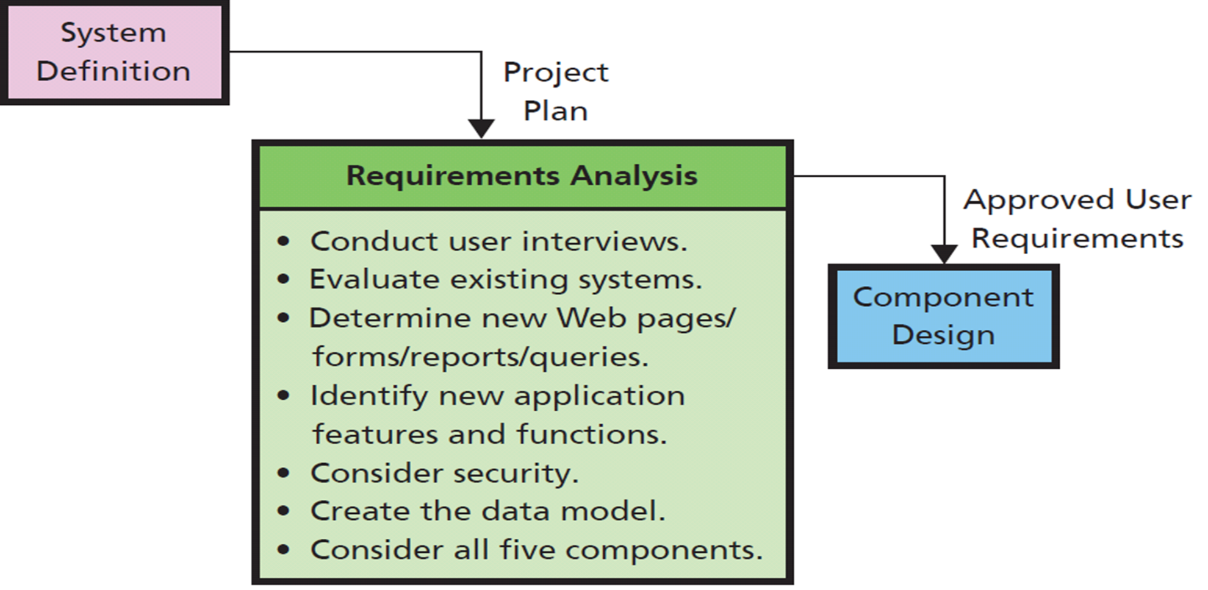
SDLC Requirements Analysis Phase
Notes:
Most important phase in the systems development process. If requirements are wrong, the system will be wrong. If requirements are determined completely and correctly, then design and implementation will be easier and more likely to result in success.

Slide 29
Software Design
Software design depends on source of programs
Off-the-shelf software
Off-the-shelf-with-alteration software
Custom-developed programs
Decide where application processing will occur
Mobile devices
Processing can occur on cloud-servers, or a mixture
Thin-client or native application?

Slide 30
Database Design
Convert data model to database design using techniques like those described in Chapter 5
If using off-the-shelf programs, then little database design needed; the programs will handle their own database processing

Slide 31
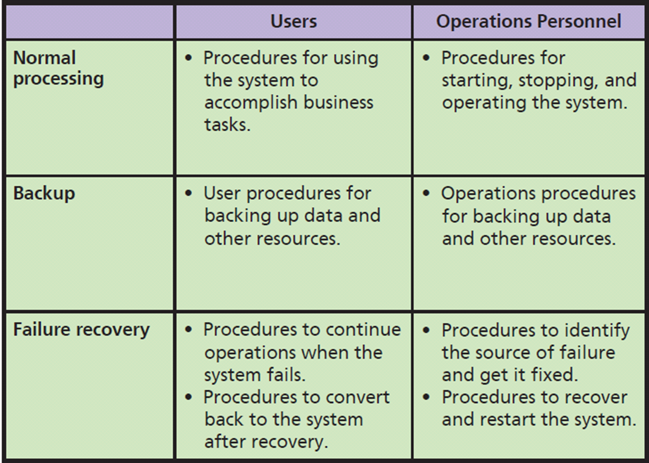
Procedure Design
Notes:
Usually, teams of systems analysts and key users design procedures.
Procedures for both users and operations personnel.
Procedures need to be developed for normal, backup, and failure recovery operations, as summarized in Figure 12-7. procedures for both users and operations personnel. Procedures need to be developed for normal,
backup, and failure recovery operations, as summarized in Figure 12-7. Usually, teams of systems
analysts and key users design the procedures.

Slide 32
Design of Job Descriptions
Teams of systems analysts and users determine job descriptions, functions for users and operations personnel
New information systems may require creating new jobs
Duties and responsibilities need to be defined in accordance with human resources policies
Usually, new duties and responsibilities added to existing jobs

Slide 33
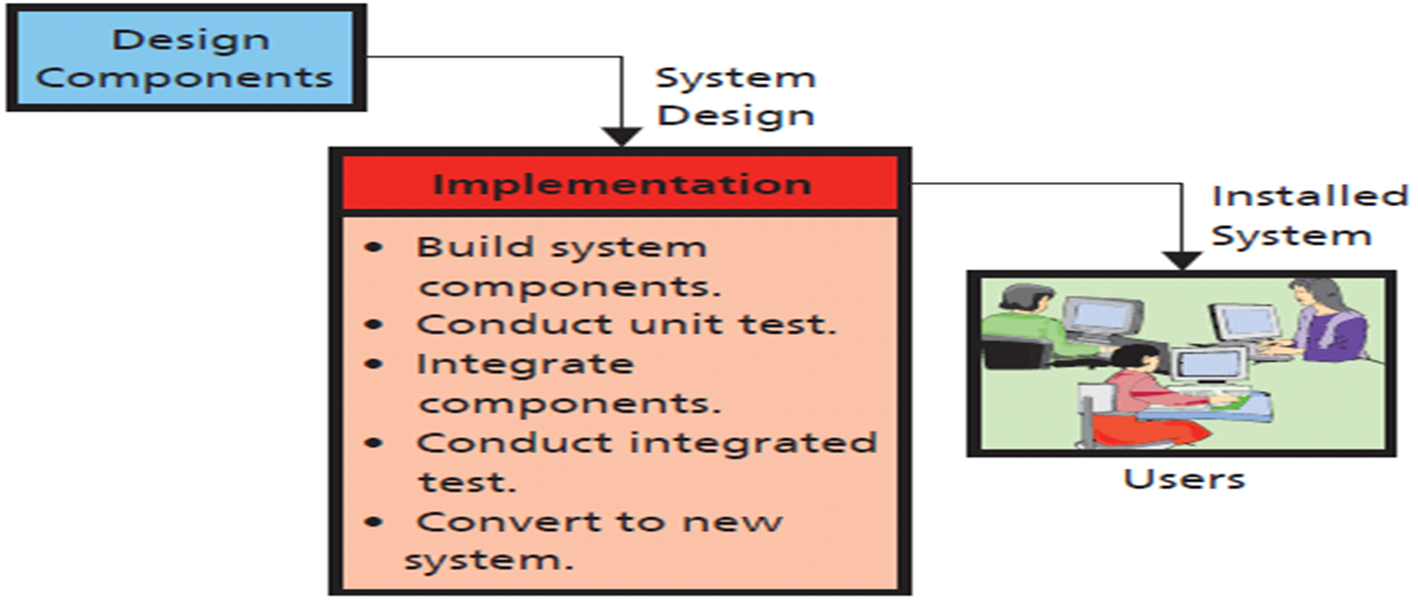
Q7: How is an Information System Implemented?
Notes:
Tasks in this phase are to build, test, and convert users to new system.
Implementation has two meanings. It could mean to implement the information systems components only, or it could mean to implement the information system and the business processes that use the system.
A test plan, which is a formal description of the system’s response to use and misuse scenarios, is written. Professional test engineers, called product quality assurance (PQA) test engineers, are hired for this task. Teams of these engineers are augmented by users as well.

Slide 34
System Testing
Test plan
Product Quality Assurance (PQA)
User testing
Develop test plans and test cases.
Beta testing
Users final say on whether system “production ready”
Notes:
A test plan consists of sequences of actions that users will take when using the new system. Test plans include not only the normal actions that users will take, but also incorrect actions. A comprehensive test plan should cause every line of program code to be executed.
Test plan should cause every error message to be displayed. Testing, retesting, and re-retesting consume huge amounts of labor. Often, developers can reduce the labor cost of testing by writing programs that invoke system features automatically.
PQA personnel usually construct the test plan with the advice and assistance of users. PQA test engineers perform testing, and supervise user test activity. Many PQA professionals are programmers who write automated test programs.

Slide 35
System Conversion Approaches
Pilot | Implement entire system in limited portion of business. Limits exposure to business if system fails.
Phased | System installed in phases or modules. Each piece installed and tested.
Parallel | Complete new and old systems run simultaneously. Very safe, but expensive.
Plunge | High risk if new system fails. Only if new system not vital to company operations.
Notes:
IS professionals recommend any of first three, depending on circumstances. Avoid the plunge, if possible.

Slide 36
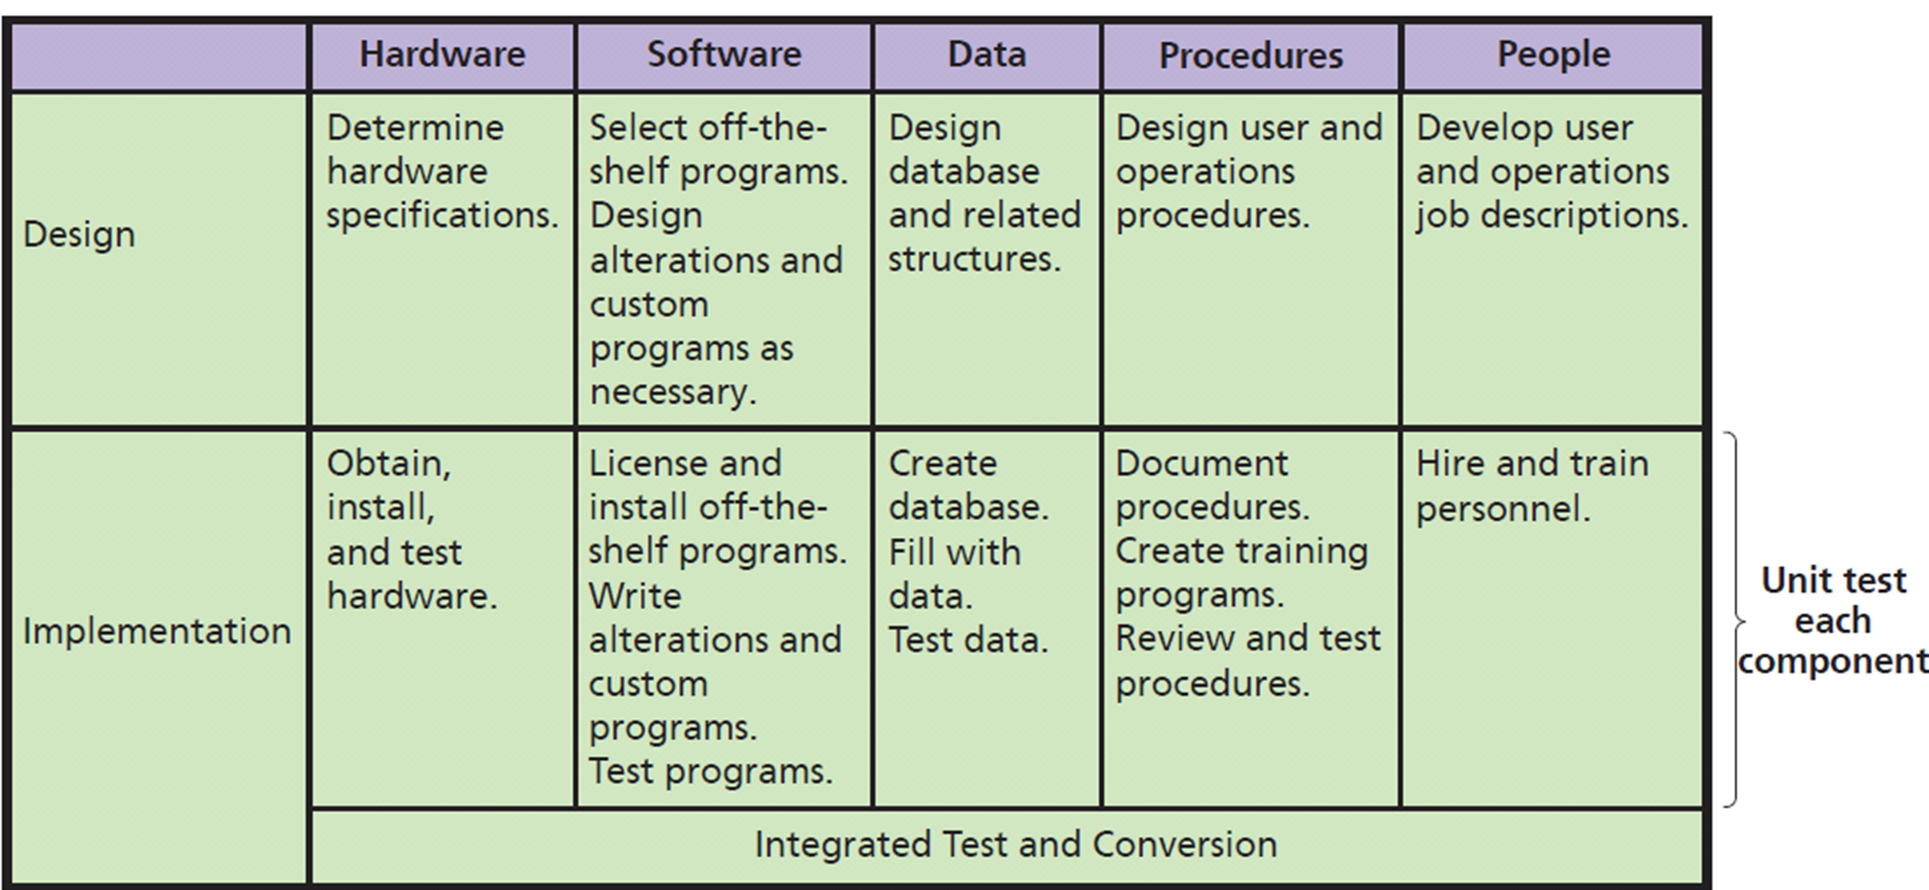
Design and Implementation for the Five Components
Notes:
This table summarizes the tasks for five IS components during the design and implementation phases.

Slide 37
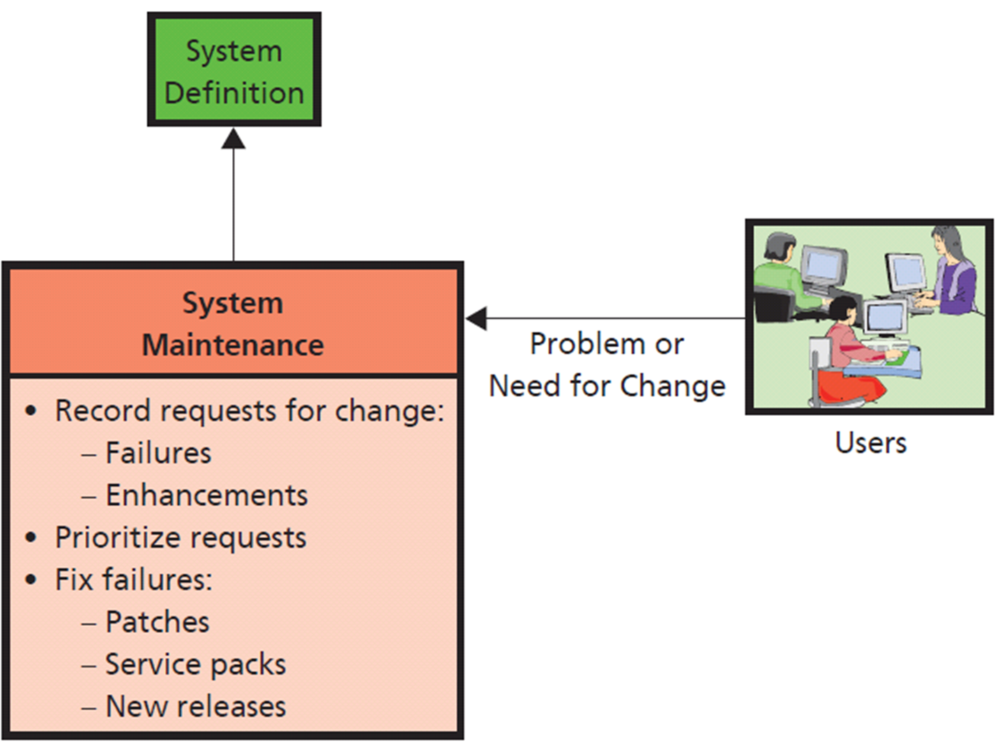
Q8: What are the Tasks for System Maintenance?
Failure is a difference between what system does and what it is supposed to do.
Notes:
Maintenance a misnomer; work done during this phase is either to fix system so that it works correctly or to adapt it to changes in requirements.
Need to have a means for tracking both failures and requests for enhancements to meet new requirements.
Software developers group fixes for high-priority failures into patches and service packs.
There needs to be a means for tracking both failures and requests for enhancements to meet new requirements. Many organizations find it necessary to develop a tracking database. This database contains a descriptions of failures and enhancements, who reported them, who made the fix or enhancement, status of that work, and whether the fix or enhancement was tested and verified by the originator.
IS personnel prioritize system problems according to their severity.

Slide 38
Q9: What Are Some of the Problems with the SDLC?
SDLC Waterfall Method
Requirements documentation difficult
Business requirements change
“Analysis paralysis” – Spend so much time on documentation, it hampers progress
Scheduling and budgeting difficulties
Time and cost estimates for large project way off
People who make initial estimates know little about how much time it will take or cost
Notes:
The process is supposed to operate in a sequence of non-repetitive phases. For example, the team completes the requirements phase and goes over the waterfall into the design phase and on through the process.
Waterfall rarely works smoothly, causing development team to go back and forth, raising costs and delaying project.

Slide 39
How Does the Knowledge In This Chapter Help You?
You will be involved in development projects as a business professional
Given robots, drones, driverless cars, and 3D printing, how will anyone in manufacturing, operations, marketing, accounting, finance not be involved in systems development?
All business grads will play strong roles in developing new systems strategies and priorities as well as managing projects
Expect IS to help you do your job
Knowledge in this chapter will get you started on right path

Slide 40
Ethics Guide: Estimation Ethics
Estimating just a “theory”
Average of many people’s guesses
Buy-in game
Projects start with overly optimistic schedules and cost estimates
When is a buy-in within accepted boundaries of conduct?
Notes:
GOALS
Introduce concept of buy-in as it pertains to information systems.
Assess ethics of buy-ins in different settings.
A buy-in occurs when a company agrees to produce a system or product for less money than it knows the project will require. You can buy-in on schedule as well as cost.

Slide 41
Ethics Guide: Estimation Ethics (cont'd)
Contractor agrees to produce system for less than what really costs
Time and materials contract
Fixed-cost contract
In-house projects often start with buy-ins
Start with hopes of more money later
Team members disagree about costs. Do you report it?
Not all costs included in initial estimates. Report it?
Do you buy-in on project schedule if you know you can’t make that schedule?
Notes:
One major goal is to see how buy-ins apply to information systems projects. Future managers need to know this to guard against, or at least consider, possibility of a buy-in.
Future managers need to consider their own values and principles.

Slide 42
Ethics Guide: Estimation Ethics (cont'd)
Be aware of buy-ins occur, some vendors make a practice of bidding projects with them
Carefully scrutinize unbelievably low bids
No substitute for experience
Hire expertise to evaluate bids
Consider your own position on buy-ins
Can you ever justify one? If so, when?
Notes:
One major goal is to see how buy-ins apply to information systems projects. Future managers need to know this to guard against, or at least consider, possibility of a buy-in.
Future managers need to consider their own values and principles.

Slide 43
Guide: Final, Final Word
Learn to find, create, and manage innovative applications of IS technology
Two important takeaways:
Software developers are optimists
Be aware of consequences of negotiating a schedule
Large projects much harder to schedule than small ones.
If project lasts longer than a year, watch out! Longer projects mean more chance for technology change, requirements change, and employee turnover
Notes:
GOALS
Inspire students to use what they have learned to find, create, and manage innovative applications of IS technology.

Slide 44
Guide: The Final, Final Word (cont'd )
Use what you’ve learned in this class to obtain the job you really want!
Do the exercises at the end of this guide, and use the answers in your job interviews!
Notes:
WRAP UP
The best is yet to come!
What that best is, what happens next, will be in large measure up to you!
We started this book with a firing and we’re ending it, we hope, with a hiring… yours!

Slide 45
Active Review
Q1: What is systems development?
Q2: Why is systems development difficult and risky?
Q3: What are the five phases of the SDLC?
Q4: How is system definition accomplished?
Q5: What is the users’ role in the requirements phase?
Q6: How are the five components designed?
Q7: How is an information system implemented?
Q8: What are the tasks for system maintenance?
Q9: What are some of the problems with the SDLC?
How does the knowledge in this chapter help you?
Notes:
Remind students that as a business professional, they will be involved in the development of new technology applications their business, and may take the lead in in developing an application.

Slide 46
Case Study 12: When Will We Learn?
#1 reason for failure (1974) -- a lack of user involvement in creating and managing system requirements
Access CT project (2013) successful
Made trade-offs to reduce project difficulty and risk
Requirements reduced to bare minimum to get system running. After success, add to it.
Notes:
GOALS
Illustrate difference between application development and systems development.
Motivate need for the SDLC or other development process.
Illustrate some difficulties in creating and managing an inter-enterprise system.

Slide 47
Case Study 12: When Will We Learn? (cont'd)
Avoid “No Wrong Door” policy
Everything for everyone
If schedule and funding are fixed, identify what factors can be traded off to reduce project difficulty and risk
Software and systems pure thought-stuff
Easy to imagine glorious future of amazing capability, but constrained by human reality
Nine women can’t gestate a baby in 1 month

